Slide 1
Team 2 | Final Presentation
Jenny Chan, Patrick Zhu, Gaurav Law, Isaac Vergara
Fall 2025

Slide 2
Introduction - Motivation & Research Topic
Background
Growing importance of ML in credit risk (2008 financial crisis, post-2015 FinTech, Industry 4.0)
Industry trajectory: shifting towards alternative data
  Since July, FHFA has allowed lenders to use VantageScore 4.0 for mortgage loans sold to Fannie Mae and Freddie Mac
Credit risk models determine inclusion in financial system (defines who gets opportunity)
Research Topic
How do we design models that are accurate, fair, and transparent?
Objectives
  Research designs and limitations for current major third-party consumer credit scoring systems (FICO, VantageScore, Bureau Proprietary Scores)
  Build a ML credit scoring model to responsibly expand access to credit, particularly for thin-file users

Slide 3
Non-Technical Project
FICO
  Designed to provide consistent, interpretable, comparable scores for underwriting, pricing, and compliance
    Uses logistic regression → easy to explain
    Limited variable set → keeps the model stable across economic cycles
VantageScore 4.0
  Designed to score more consumers, including thin-files and new-to-credit and improve predictive power
    ML-based weighting → captures nonlinear patterns, improving accuracy for consumers with limited files
    Inclusion of alternative data → helps to score credit thin or credit invisible
ML-First Fintech Scores (e.g., Upstart, Zest AI)
  Designed to use ML to uncover nonlinear patterns and improve predictive power
    Upstart reports its model can approve 27% more borrowers at the same default rate while reducing APRs by 16% for approved loans
    Their trade-offs are "black box" interpretability, model risk, and intense regulatory scrutiny regarding fairness and bias

Slide 4
What Is Risk Management (and Why It Matters)?
Core function in banks, mortgage lenders, card issuers, and analytics firms.
Goal: identify, measure, monitor, and mitigate key risks
  Credit, market, operational, liquidity, model risk.
In credit markets, tightly linked to:
  Credit scoring and underwriting
  Portfolio monitoring and capital planning.
Credit scores and internal models shape:
  Who gets approved, at what limit, and at what price.

Slide 5
Major Career Paths in Risk Management
Credit Risk
  Focus: borrowers not repaying.
  Roles: Credit Risk Analyst, Credit Policy Analyst, Portfolio Risk Manager, Credit Risk Modeler.
Market Risk
  Focus: losses from interest rates, equity prices, FX, credit spreads.
  Roles: Market Risk Analyst / Manager.
Operational / Non-Financial Risk
  Focus: processes, people, systems, external events (fraud, cyber, model implementation errors).
  Roles: Operational Risk Analyst, Fraud Risk Manager.
Model Risk Management (MRM) & Quantitative Risk
  Focus: models being wrong, misused, or poorly governed.
  Roles: Model Risk Analyst, Model Validator, Quantitative Risk Specialist.
Enterprise / Regulatory / Compliance Risk
  Focus: firm-wide risk appetite, governance, and regulatory interaction.
  Roles: Enterprise Risk Analyst, Risk Governance Associate, Regulatory Risk Analyst.

Slide 6
Company Specific Roles Linked to the Project
Fannie Mae–Mortgage and Model-focused Risk Roles
  Capital Markets Risk Senior Associate: Monitor risk on large portfolios and review risk metrics and reports.
  Lead Quantitative Modeler: Develop models for mortgage cash flows, borrower behavior, stress testing using Python, SAS, and SQL
FICO–Software Delivery for Risk
  Full Stack Engineer: Build and maintain enterprise decisioning platforms with embedded credit scores using Java, Spring, Angular, AWS, etc.
VantageScore–Research and Data Science for Credit Scoring
  Senior Research Analyst – Economic and Consumer Insights: Analyze VantageScore credit data and macro consumer datasets, and produce reports and visualizations for lenders, regulators, and media

Slide 7
Skill Requirements and Career Progression
Core skill mix across paths
  Quantitative & statistical skills
  Data handling and programming (e.g., Python / R / SQL / SAS)
  Financial product and credit-domain knowledge
  Clear written and verbal communication for business and regulators.
Typical career progression
  Start: Analyst in a specific area (e.g., credit risk, model risk).
  Then:
    More specialized technical expert, or
    Broader portfolio / enterprise risk role, or
    Leadership role facing senior management and regulators.

Slide 8
Technical Project
Survival Analysis for Mortgage Portfolio Risk Management

Slide 9
Background
Time-to-Default: Snapshot of loan life cycle
  Accommodates time-varying risk
  Lifetime PD estimates
Cox Proportional Hazards
  Instantaneous loan default risk
  Proportional Hazards Assumption
  Semi-Parametric Model: Flexibility
  Survival Curves, hazard rates

Slide 10
Survival Analysis Framework
Proper Censoring Handling
  Not qualified as default yet → needs to complete loan lifecycle
Time-to-Event Information
  Loan A: Originated January 2015, current for 130 months (strong survival evidence)
  Loan B: Originated September 2024, current for 13 months (limited survival evidence)
Differential Risk over Time
  Early default: Underwriting failures
  Late default: Macroeconomic conditions

Slide 11
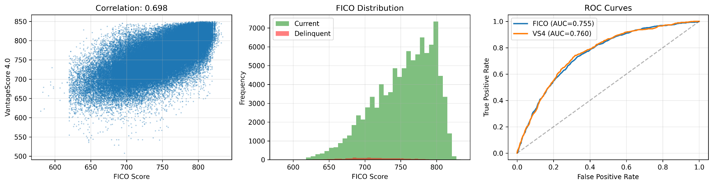
Exploratory Data Analysis
Fannie Mae Single-Family Loan Performance
  Features: total loans, delinquency events, Loan Age
Observation Period: Oct. 2025
FICO vs. VantageScore 4.0
  Loan origination
  Instantaneous scores

Slide 12
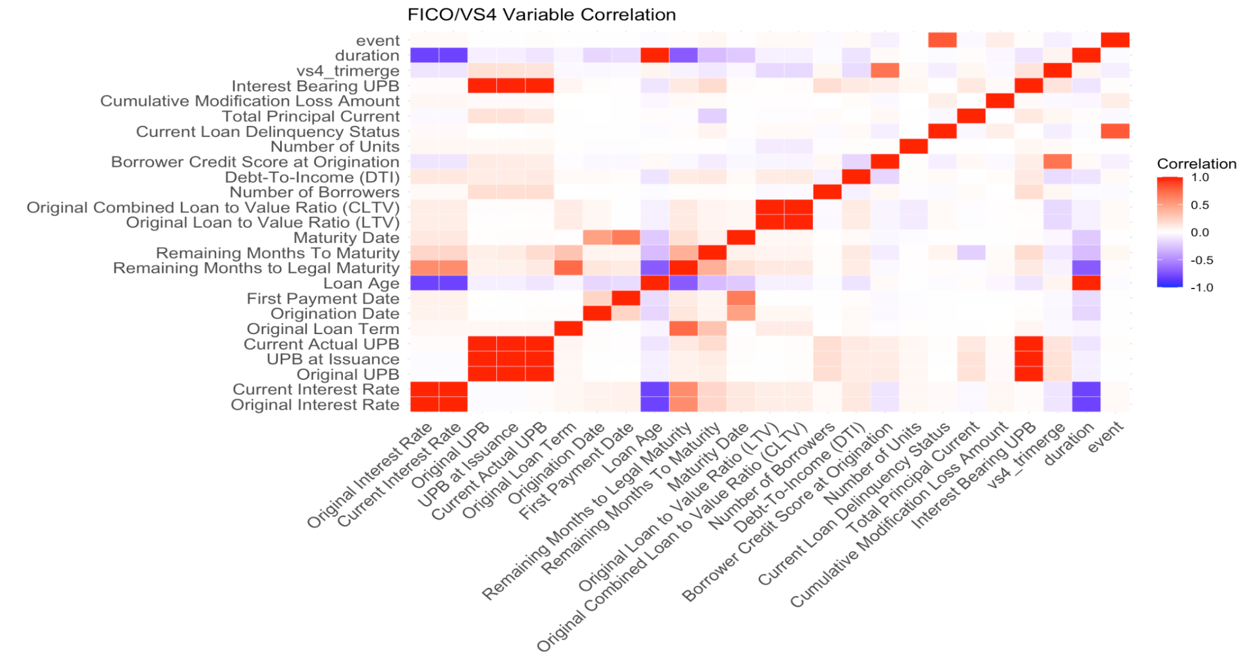
Feature Engineering
Origination + Behavioral Features
  Loan Age, Original Interest Rate, FICO, VS4
Correlation Analysis
Principal Component Analysis
25 features extracted

Slide 13
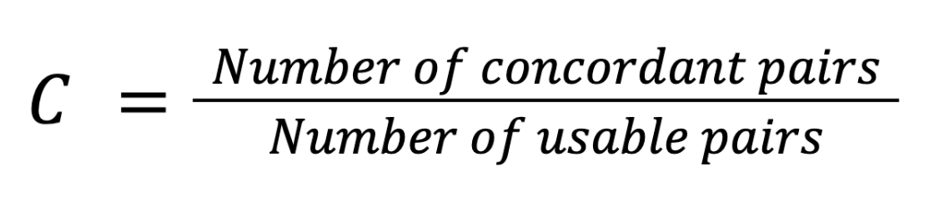
Harrell’s C-Index
Higher risk score assigned to default > non-default
Higher C-index => predictions is closer to default status
  Ex. Loan j is older + has higher pred. prob. of lasting longer than loan i
  Concordant pairs: loan i defaults before loan j
  Discordant pairs: loan j defaults before loan i
  Usable pairs: both loans have default similar time periods
Our case: Low event rates => higher C-index

Slide 14
Score freshness matters far more than score methodology.
How do FICO and VantageScore 4.0 compare in terms of predictive performance for mortgage credit risk?
Model | C-Index | Improvement vs FICO (Origination)
FICO Score (Origination) | 0.7342 | -
VantageScore 4.0 (Origination) | 0.7458 | 0.0116
Both Scores Combined (Origination) | 0.7586 | 0.0221
FICO Current | 0.9568 | 0.2226
Score Evolution Over Time
Movement | Percentage
Improved (>10 points) | 40.7%
Stable (±10 points) | 23.5%
Declined (<10 points) | 35.8%

Slide 15
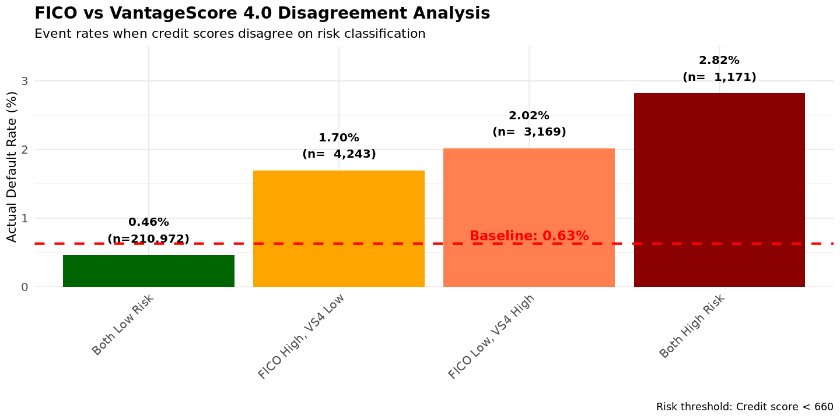
VS4 identifies 4,243 additional borrowers
To what extent do these scores differ in their treatment of “thin-file” or marginal borrowers?
High Agreement (96.6%): FICO and VS4 agree on 96.6% of the portfolio
VS4 More Accurate in Disagreement Zone:
  Borrowers approved by VS4 but rejected by FICO: 1.7% default rate
  Borrowers approved by FICO but rejected by VS4: 2.02% default rate
Credit Access Opportunity: VS4 identifies 4,243 borrowers (1.9% of portfolio) who could access credit despite FICO < 660, with elevated but manageable risk

Slide 16
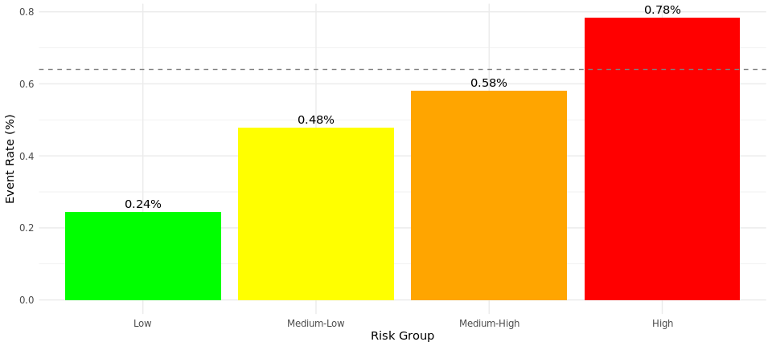
A well-specified Cox model captures nearly all available predictive signals
Can an enhanced credit model, built on a richer set of features, deliver meaningful improvements in predictive power relative to FICO and VS4?
Model | C-Index | N Features
FICO Only | 0.7342 | 1
FICO + VS4 | 0.7586 | 2
FICO + VS4 + Loan Characteristics | 0.8855 | 8
Cox Model | 0.9978 | 25
Cox Model + XGBoost | 0.9983 | 25
Risk Stratification

Slide 17
Enhanced modeling achieves access and safety simultaneously
What are the implications of such improvements for credit risk management and financial inclusion?
Portfolio Risk Management (Existing Loans)
While lenders cannot retroactively change past origination decisions, the model enables proactive portfolio management:
Early Intervention Programs
Risk-Based Servicing
The model supports Fannie Mae's dual mandate:
Liquidity: Accurate risk assessment enables better capital allocation
Access: Identifies 1,146 creditworthy thin-file borrowers
Safety & Soundness: Net -5 defaults despite expanded access.

Slide 18
Thank you!

